Slide 1
MSAS Tutorial Sequence
-Module Four-
WRITTEN BY ADVAY MUCHOOR

Slide 2

BACK AT IT

Slide 3
Goals of Today
Catch up from last time
  Pandas overview
  Reading from excel
Learn to manipulate DataFrames
  Select specific rows
  Select specific columns
Get some feedback!

Slide 4
Review from last time

Slide 5



Pandas
Welcome to REAL Data Science

Slide 6
Libraries in Python
A python library is a collection of functions that allows you to perform specific actions with your code
More often than not, a library is designed for a specific feature. There are libraries to…
  Move and modify files on your computer
  Create graphical interfaces for your code
  Webscrape (more on that in the next module)
  Perform data science operations ☺
  And much more!
Libraries can be imported with the following syntax:
  import library (imports entire library)
  import library as lib (imports entire library as an alias, usually used to not clutter up code)
  from library, import function a, b (imports functions a and b from the library, saves memory)
To access functions of your imported library, you will need to use the dot operator
  We will see this throughout the module sequence

Slide 7
What is Pandas?
From their documentation:
“pandas is an open source, BSD-licensed library providing high-performance, easy-to-use data structures and data analysis tools for the Python programming language.”
Very powerful data science library
The basis of the rest of this module, as well as the next three!
Import pandas at the top of your jupyter notebok
  import pandas as pd

Slide 8
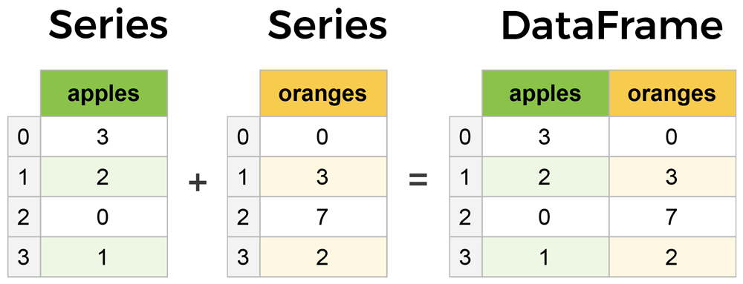
Series vs DataFrames
The primary two components of pandas are Series and DataFrames
Series is a column in your table, and a DataFrame is a multidimensional table comprised of a collection of Series

Slide 9
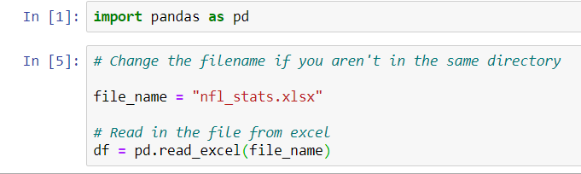
Reading in Files

Slide 10
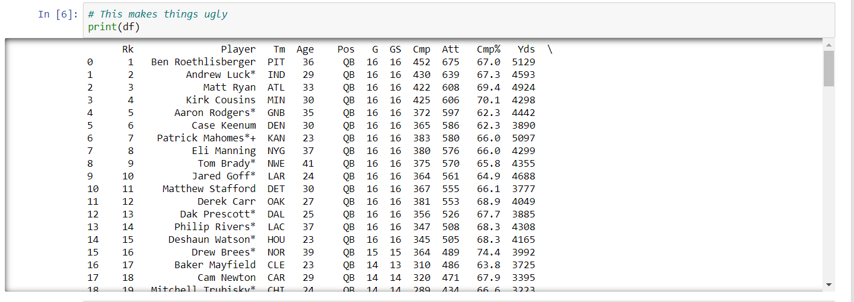
Printing a DataFrame

Slide 11
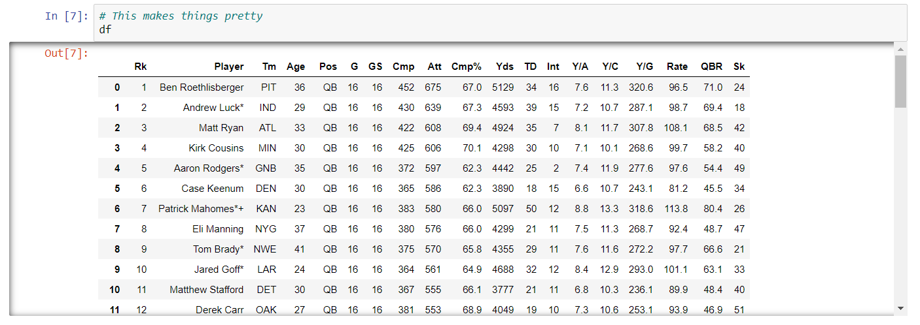
Displaying a DataFrame

Slide 12
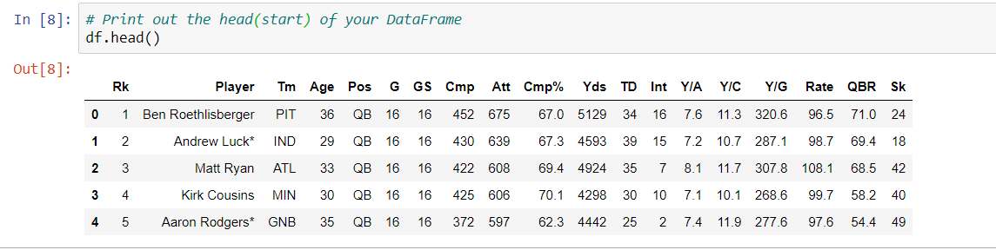
Displaying the head of a DataFrame

Slide 13
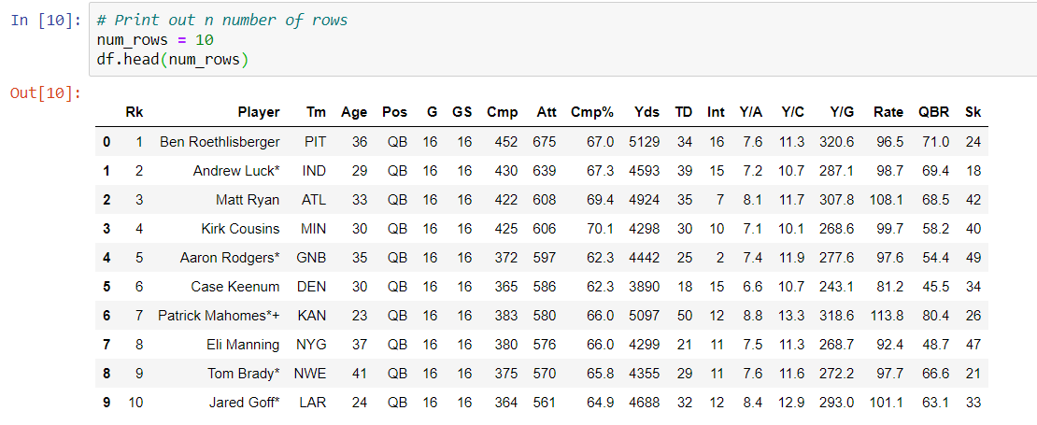
Display a Specific Number of Rows

Slide 14
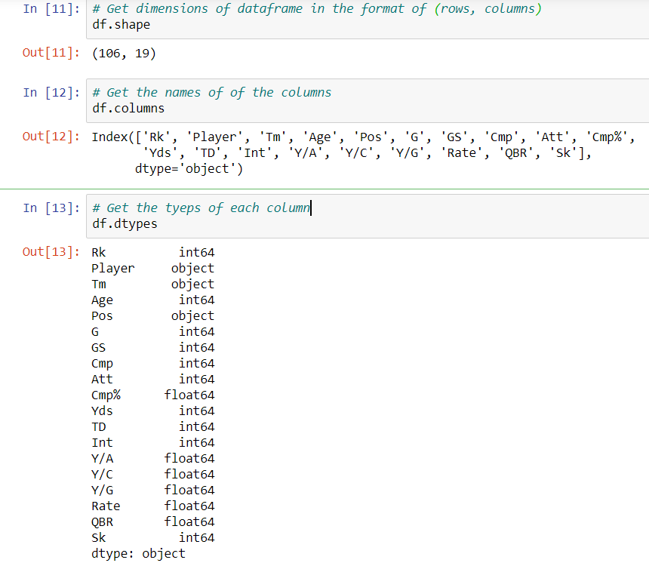
Get Information about the DataFrame

Slide 15
Let’s dive a little deeper
Extracting columns
Extracting rows
Modifying the table
  Sorting values, deleting columns, renaming the index
Combining DataFrames

Slide 16
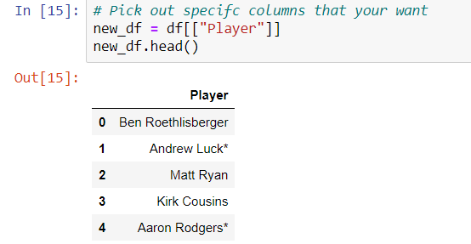
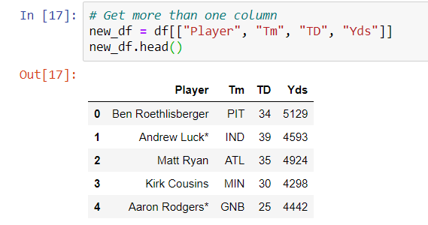
Extract Certain Columns

Slide 17
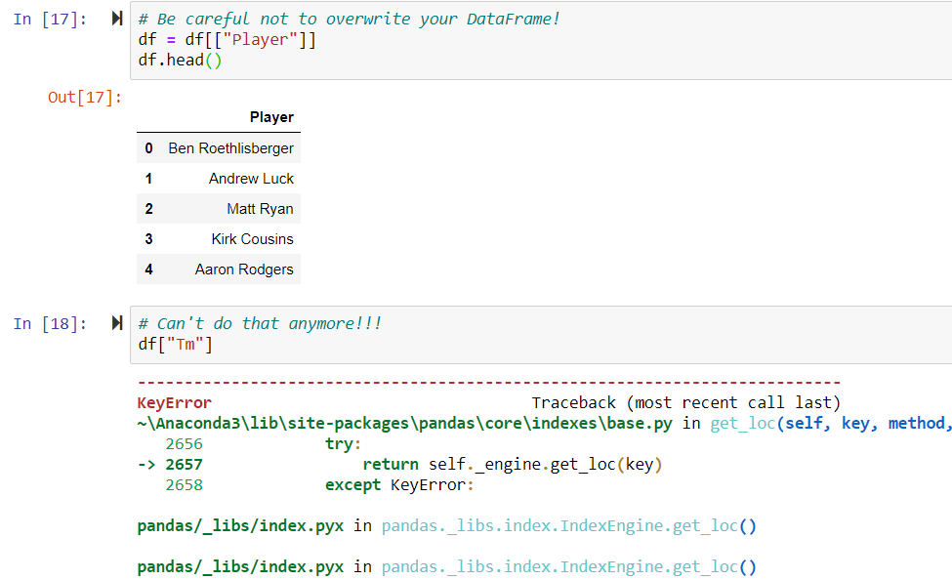
Be careful to not overwrite your DataFrame!
How do we undo this?
Re-read the table into the DataFrame (re-run the cell where it is declared)

Slide 18
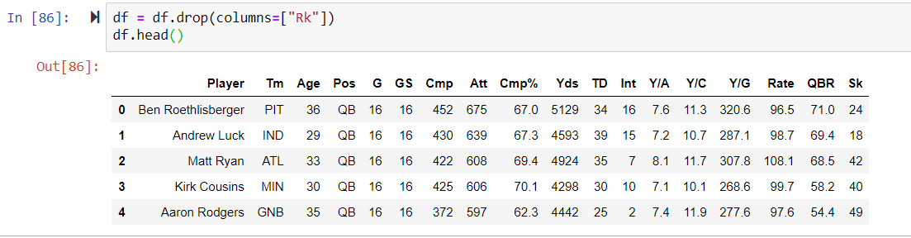
Delete a column

Slide 19
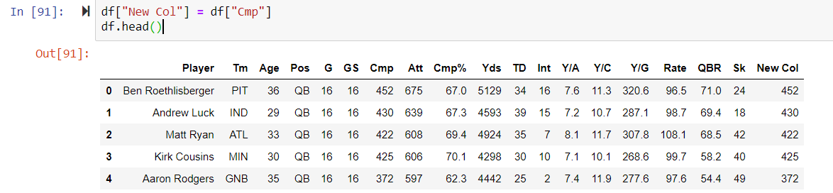
Create a new column!

Slide 20
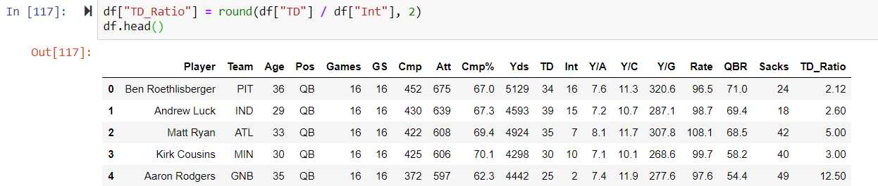
Create a new column using an operation

Slide 21
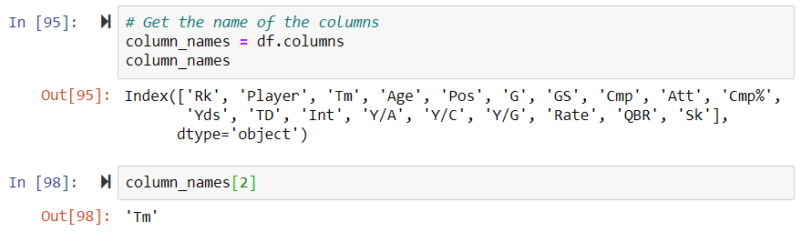
Changing column names

Slide 22
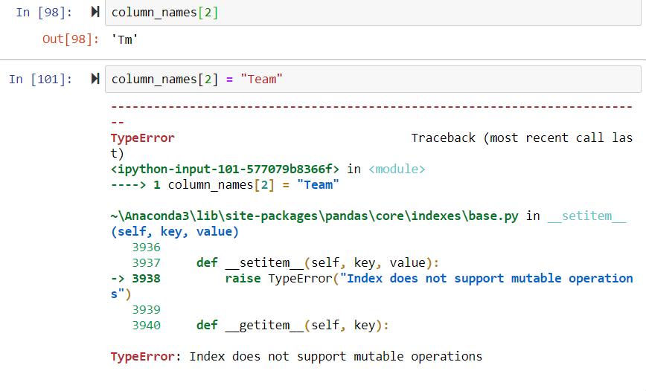
Not as easy as you’d think…

Slide 23
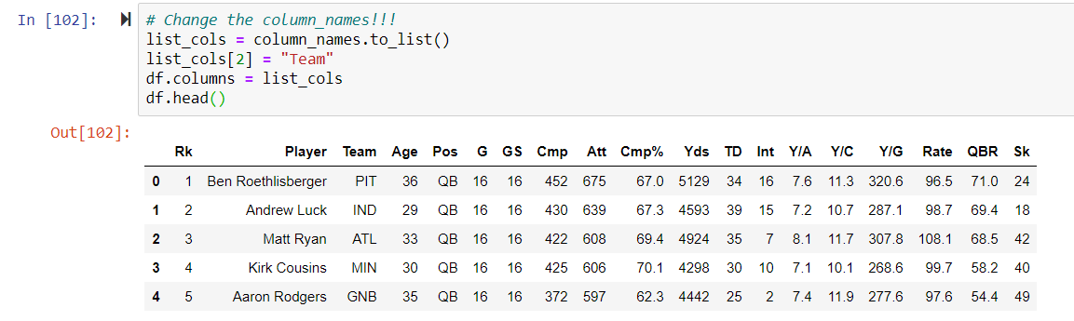
Way #1 – Beginner

Slide 24
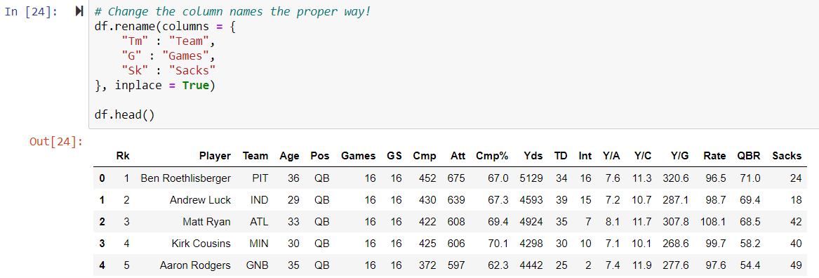
Way #2 – Advanced

Slide 25
Selecting rows
Now we'll look at getting data by rows.
For rows, we have two options:
  .loc - locates by name
  .iloc- locates by numerical index

Slide 26
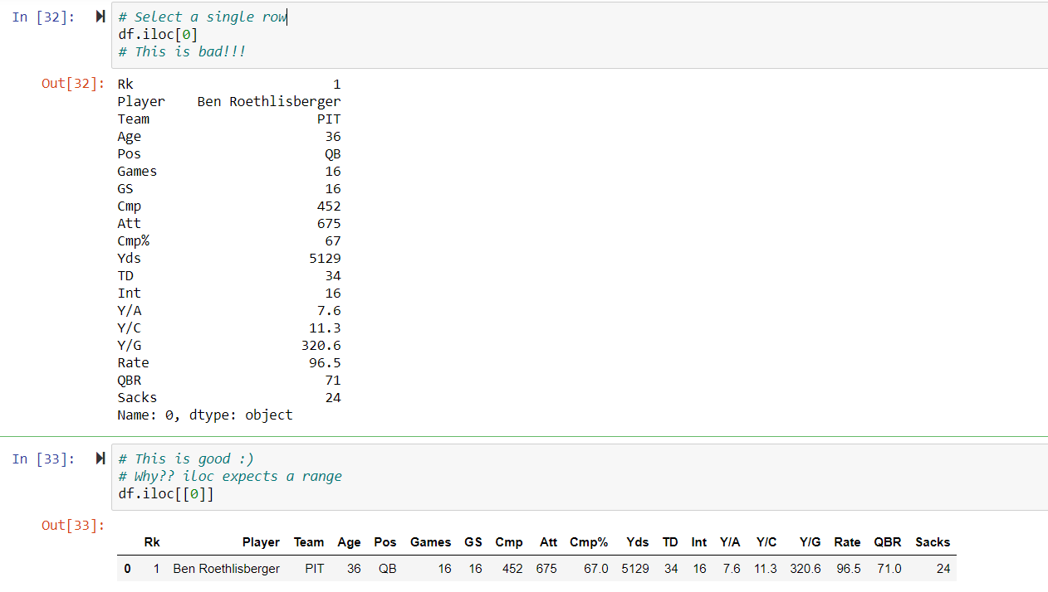
Selecting a single row using iloc

Slide 27
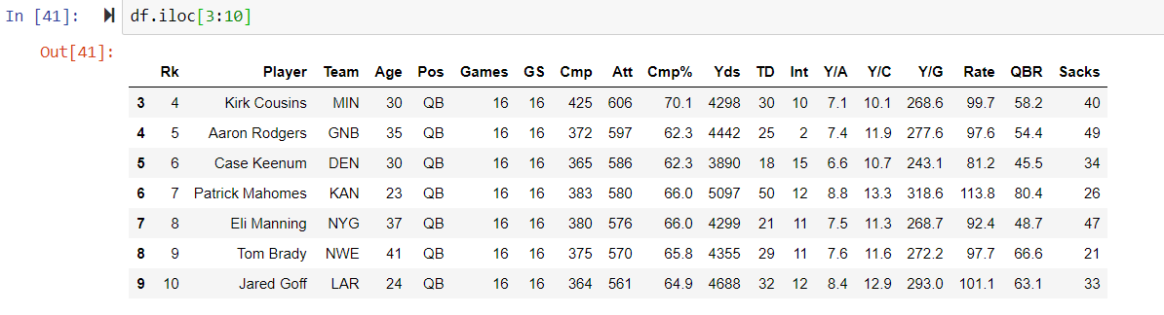
Selecting a range of rows using iloc

Slide 28
What is the “index” column?
The index column is how you access specific rows
The default will always be an increasing index unless it is set
Useful for ranges and determining order
  Not much else
Why should we change the index??
  Next slide

Slide 29
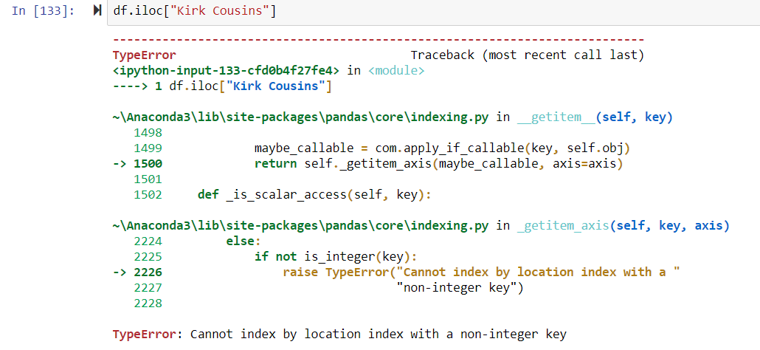
Example of a good time to change the index

Slide 30
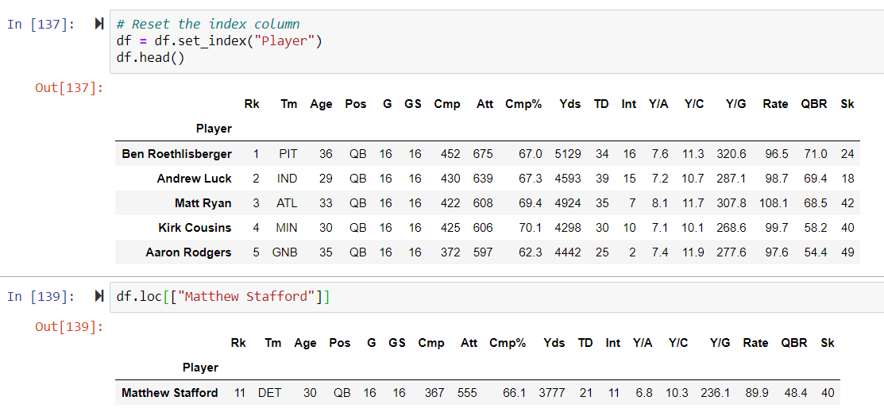
How to change the index

Slide 31
Selecting rows based on conditions
Basic operation that is extremely powerful
Allows you to view data based on criterion you want to view
Why is filtering useful?

Slide 32
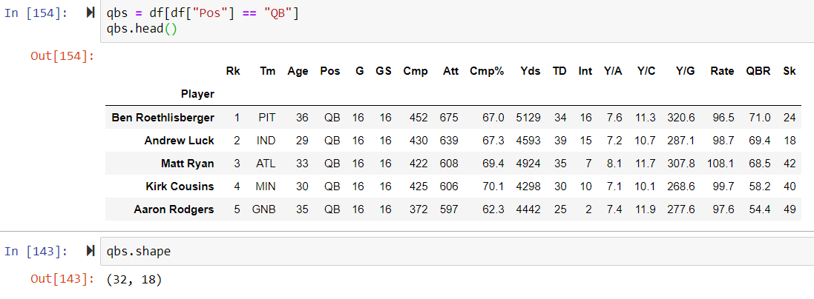
Filtering by one qualification

Slide 33
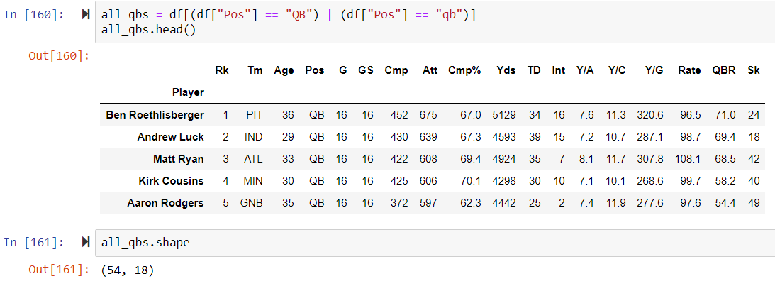
Filtering by multiple conditions

Slide 34
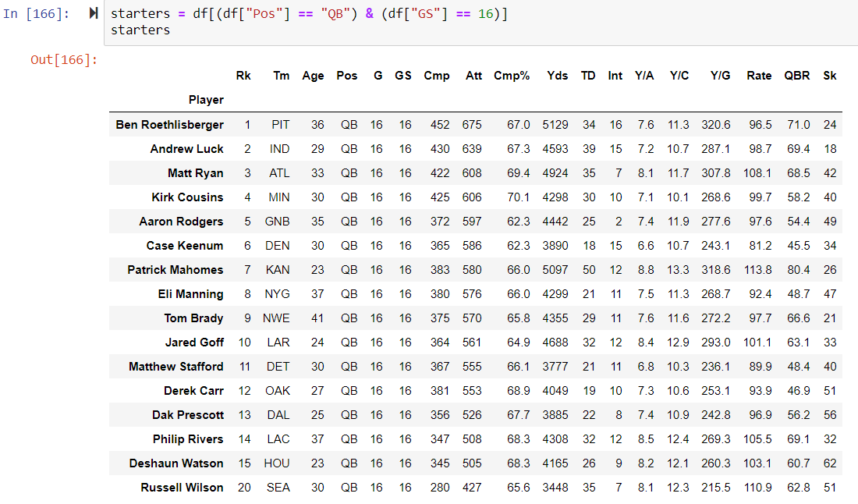
Additional Example – What does this show?

Slide 35
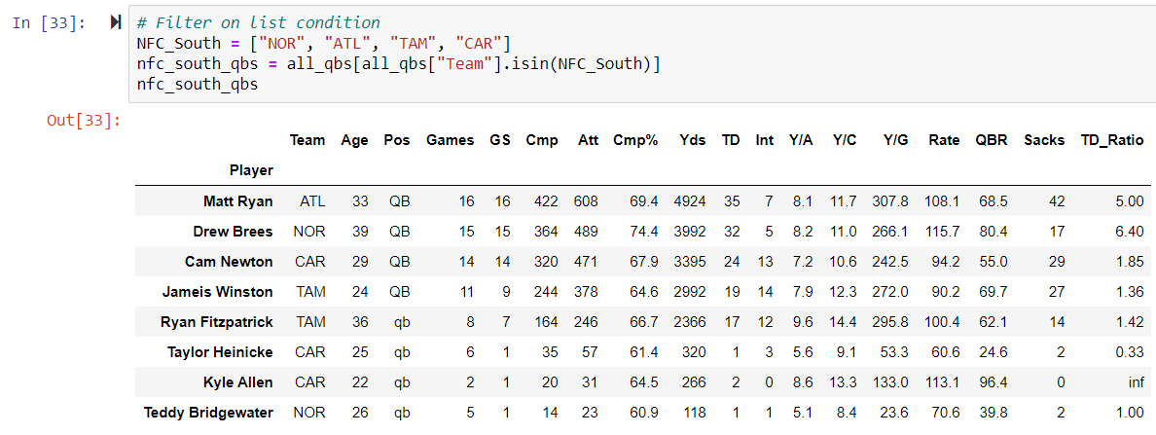
Check if element is in a list

Slide 36
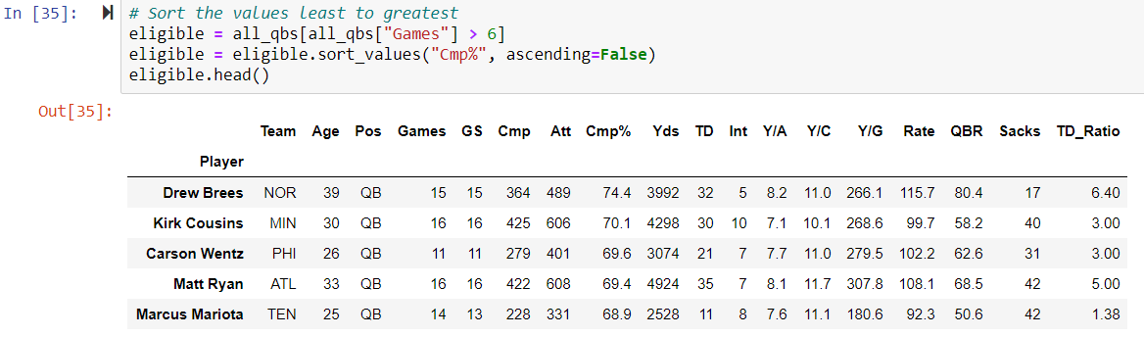
Sort Values

Slide 37
Tips for more efficient data manipulation
Never modify your original DataFrame in the middle of your notebook
  Perform all cleaning operations in the beginning
  Allows you to keep working linearly
Store modified tables in placeholder tables
  Adding or deleting rows
  Conditional filters
Use helpful names

